Slide 1

Unit 1: Nice to see you again Lesson 1
Phu Dong Primary School
Teacher: Dang Thi Huong

Slide 2

WARM UP

Slide 3

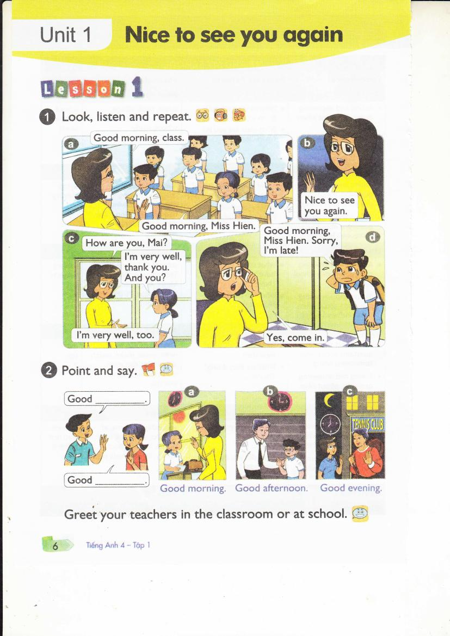
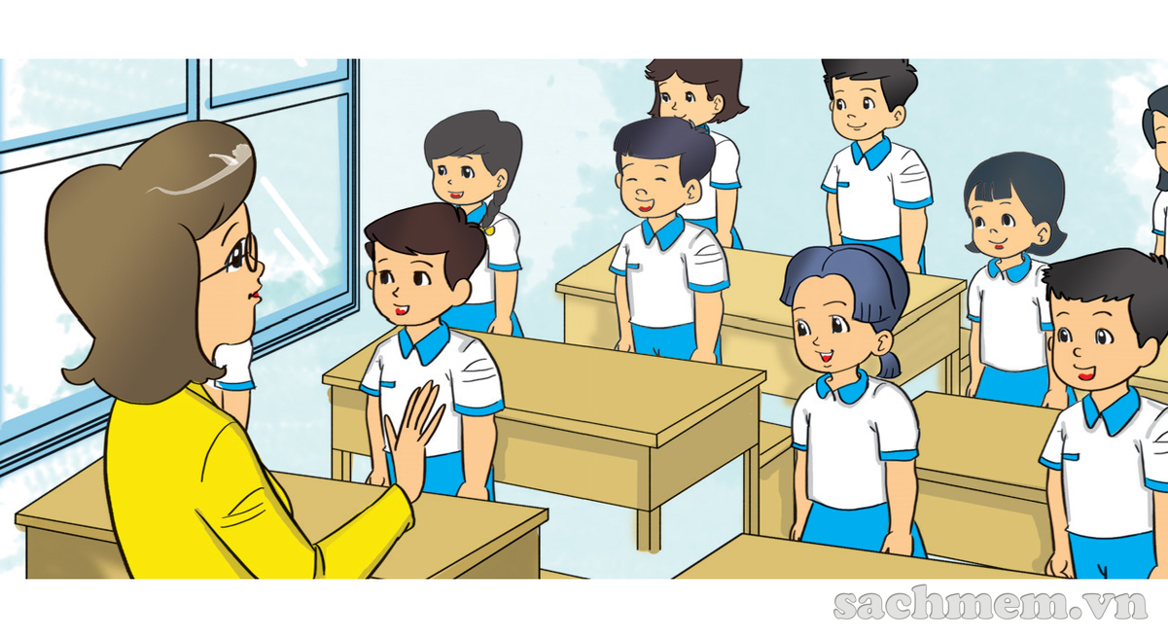

Slide 4
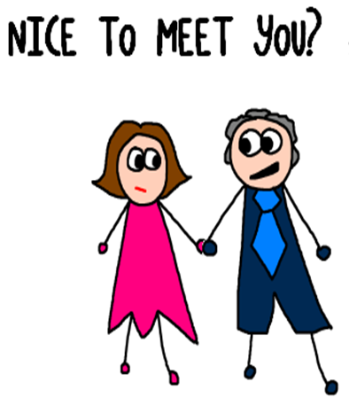

Slide 5

Good morning

Slide 6


Slide 7
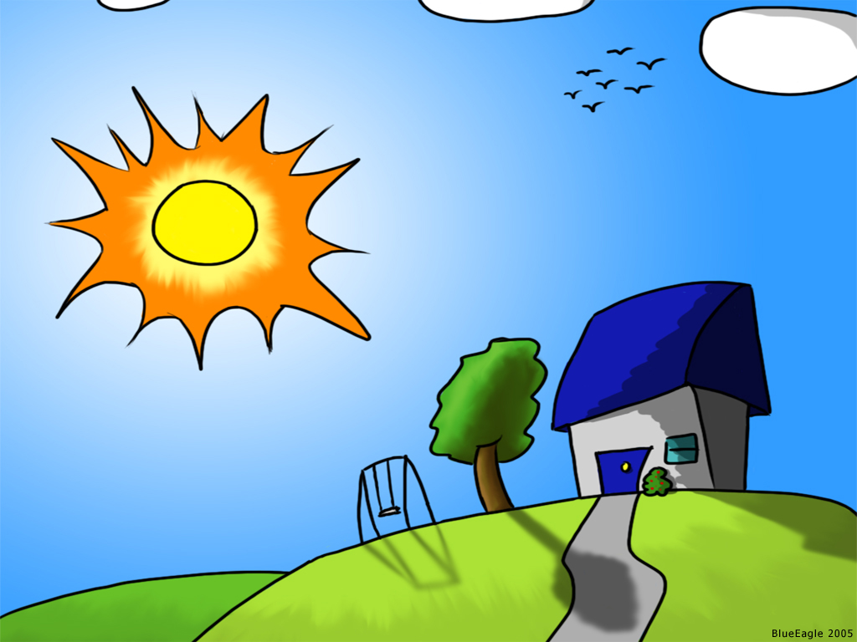
Good EVENING

Slide 8


Slide 9
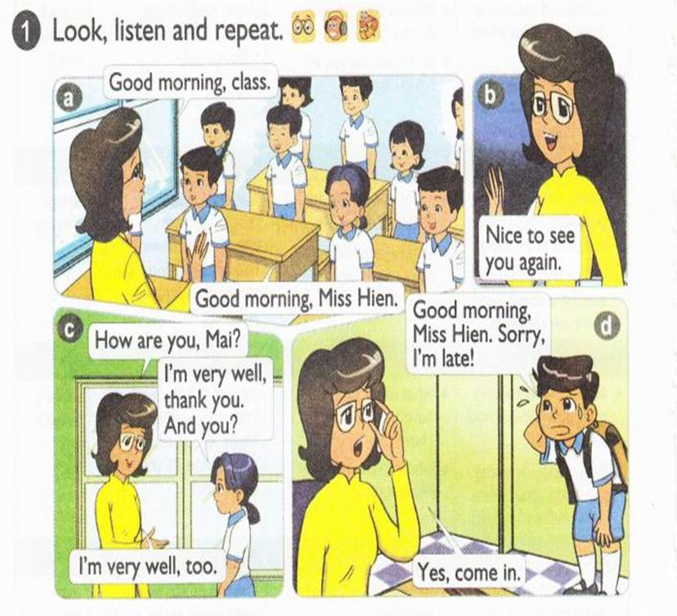


Slide 10
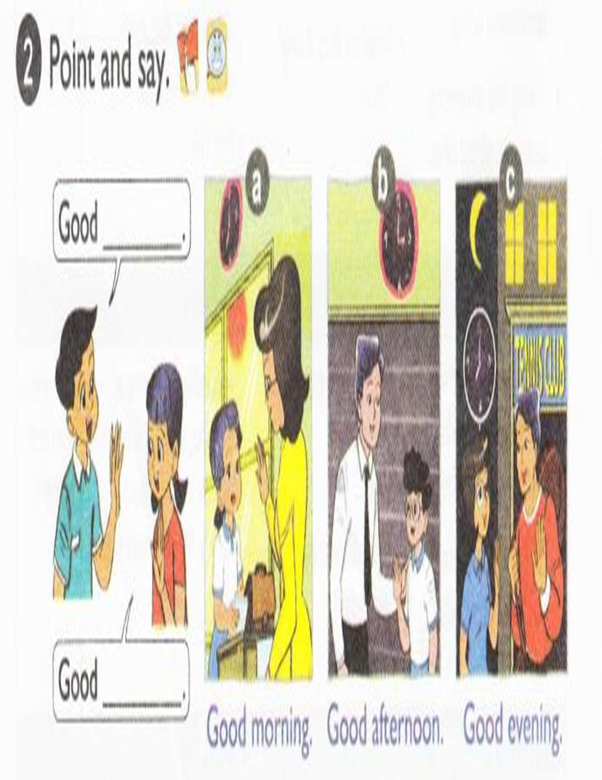

Slide 11
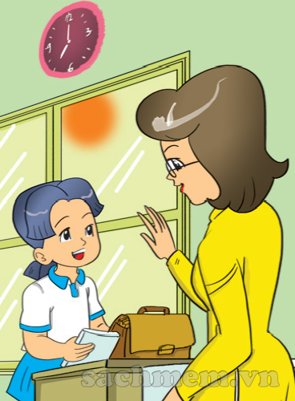
Good morning
Good morning

Slide 12
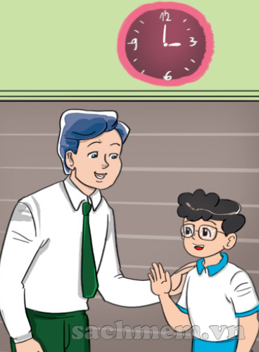
Good afternoon
Good afternoon

Slide 13

Good evening
Good evening

Slide 14
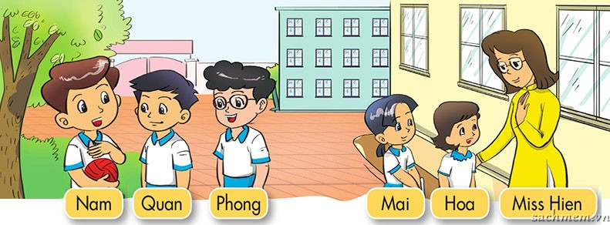


Slide 15
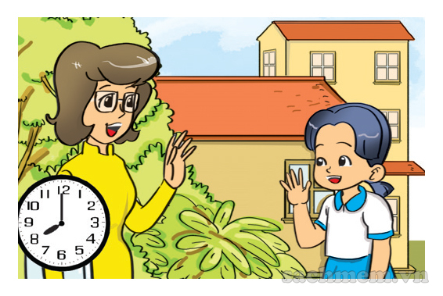
LISTEN & TICK
1
a
b
c

Slide 16
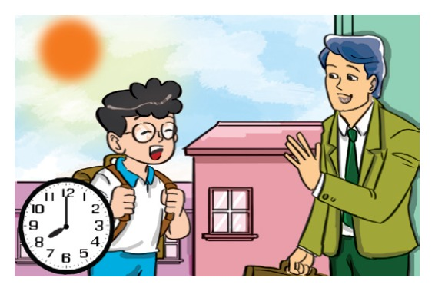
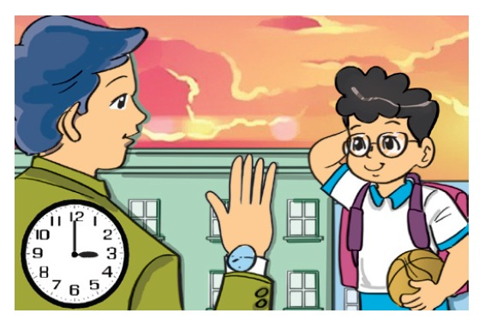
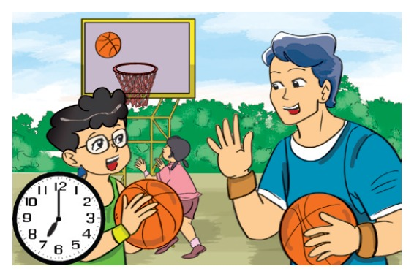
LISTEN & TICK
2
a
b
c

Slide 17
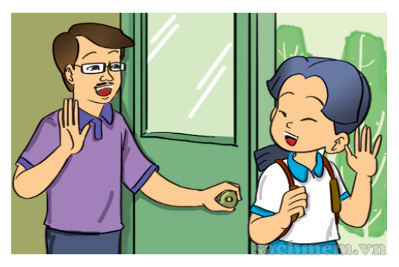
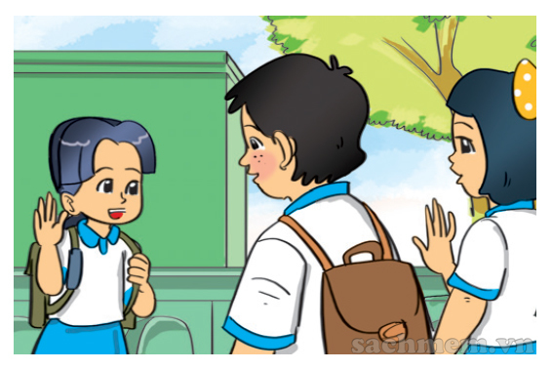
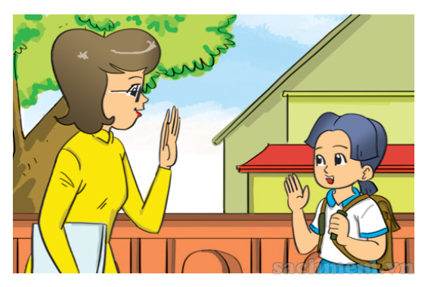
LISTEN & TICK
3
a
b
c

Slide 18
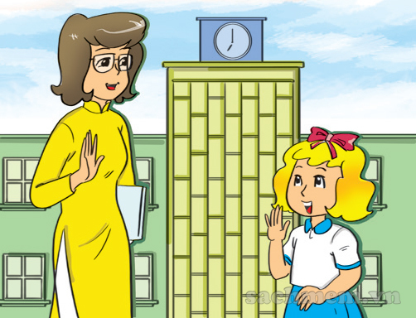
Good
morning
LOOK & WRITE

Slide 19
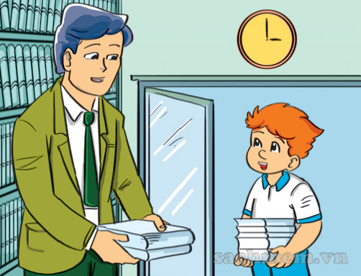
Good
afternoon
LOOK & WRITE

Slide 20
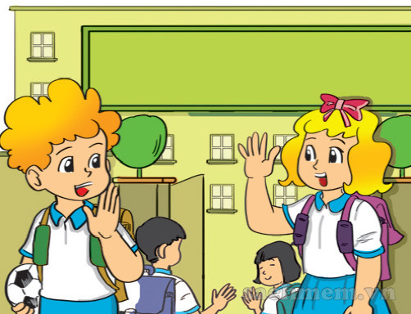
Good
bye
LOOK & WRITE

Slide 21

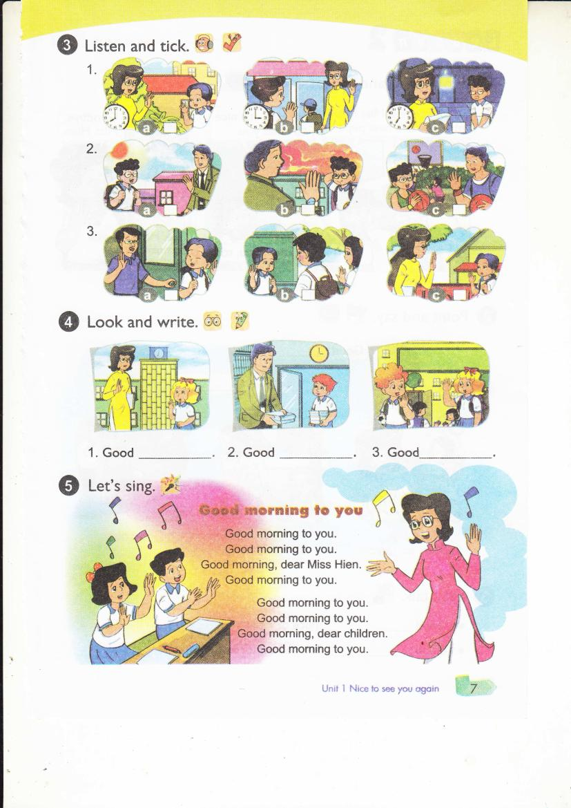

Slide 22


Slide 23
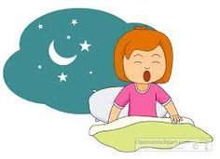
Good moning
Good afternoon
Good night
2

Slide 24

afternoon
morning
night
3

Slide 25

afternoon
morning
night
4

Slide 26
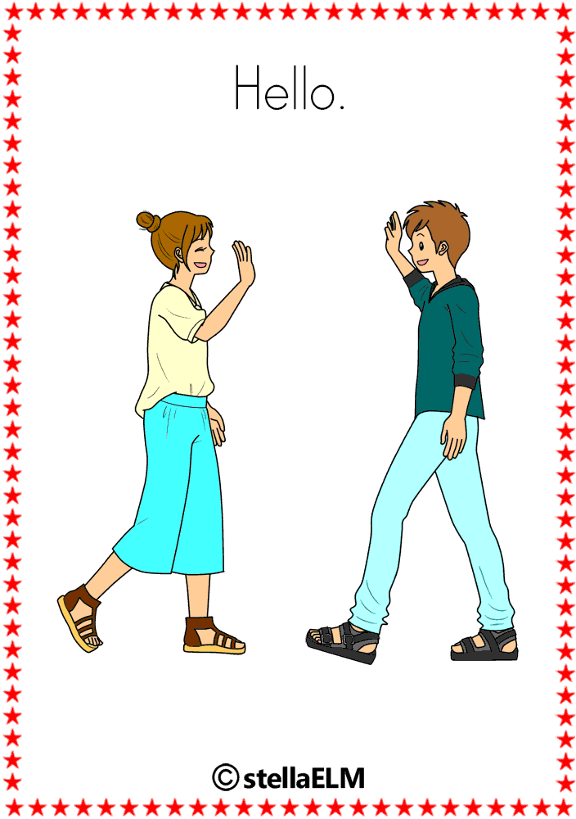
hello
Good bye
bye
5

Slide 27

BYE
GOOD BYE
NICE TO MEET YOU
6

Slide 28

BYE
GOOD BYE
HELLO/ HI
9

Slide 29
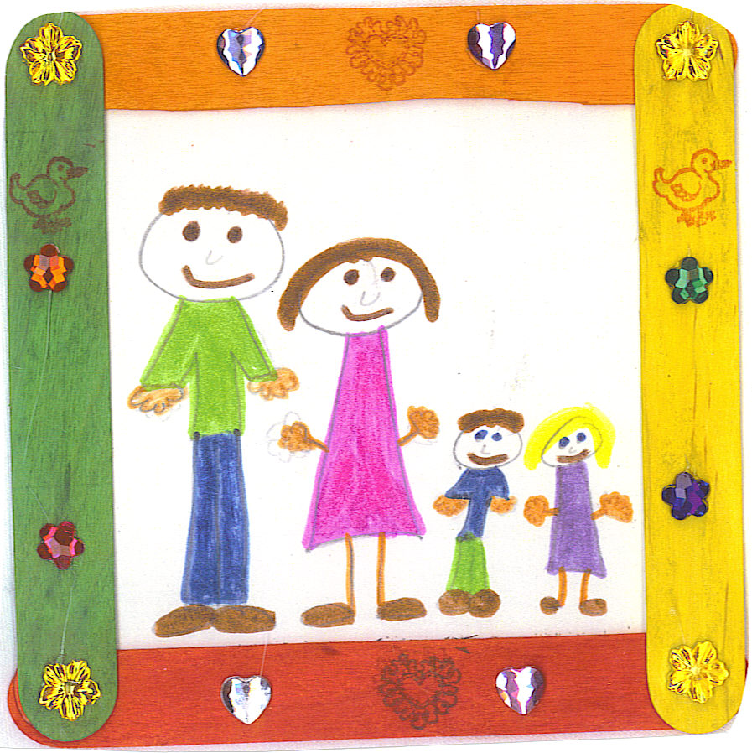


THANK YOU FOR ATTENTION!
GOODBYE
SEE YOU LATER
Để tải full bộ bài giảng 3,4,5
Quý thầy cô vui lòng truy cập:
https://ioebekeobon.violet.vn/

